Slide 1

MOVIE RECOMMENDATION SYSTEM USING COLLABORATIVE FILTERING

Slide 2

EAST WEST UNIVERSITY
Department of Computer Science and Engineering
FALL 2021
A thesis submitted in partial fulfillment of the requirements for the degree of Bachelor of Science in Computer Science and Engineering
Submitted By:
Sadman Sakib 2016-3-60-046
Rafi Md. Hasib 2016-3-60-061
Md. Fahim Sabab Siyam 2017-1-60-142
Sadia Shahreen 2017-1-60-071
Supervised By:
Surajit Das Barman
Senior Lecturer
Department of Computer Science and Engineering,
East West University.

Slide 3


1. PROBLEM STATEMENT
2. Motivation
3. Literature Reviews
4. METHODOLOGY
5. PREDICTION ALGORITHM OR CLASSIFIER ALGORITHMS
6. EXPERIMENTAL RESULTS ANALYSIS
7. LIMITATIONS AND FUTURE WORK
8. CONCLUSION
SUMMARY
OF THE
PRESENTATION
3

Slide 4
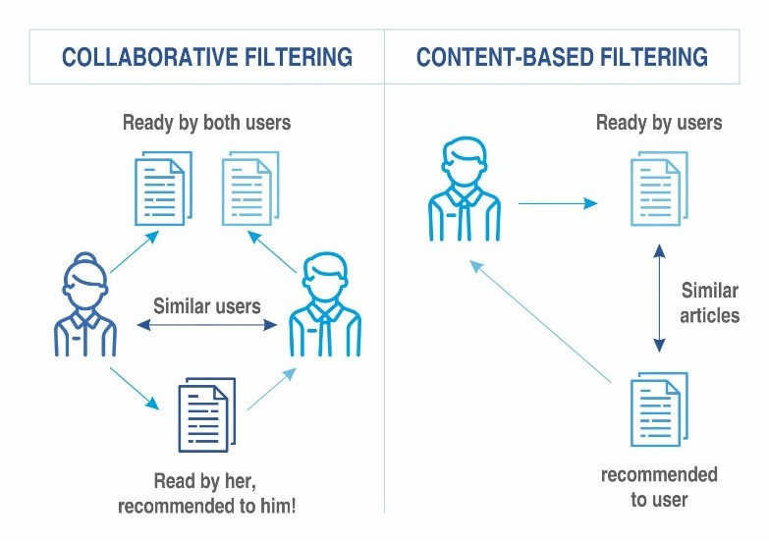
Problem Statement
Rating Prediction
Accuracy
Dimension Reduction
4

Slide 5
OUR
MOTIVATION
VISION STATEMENT
MISSION STATEMENT
HONESTY & INTEGRITY
The use of recommender systems has become popular in our daily online lives, from e-commerce to online advertising .
Recommender systems, in a broad sense, are algorithms designed to suggest useful products to users.
In some industries, recommender systems are critical because they can generate a significant amount of revenue if they are effective, or they can help a company stand out from the competition.
Movie Recommendation
5

Slide 6

About
LITERATURE REVIEWS
The effectiveness of collaborative Filtering.
Item-to-Item Collaborative Filtering.
The problem of personalized recommendations.
Movie Recommendation
6

Slide 7
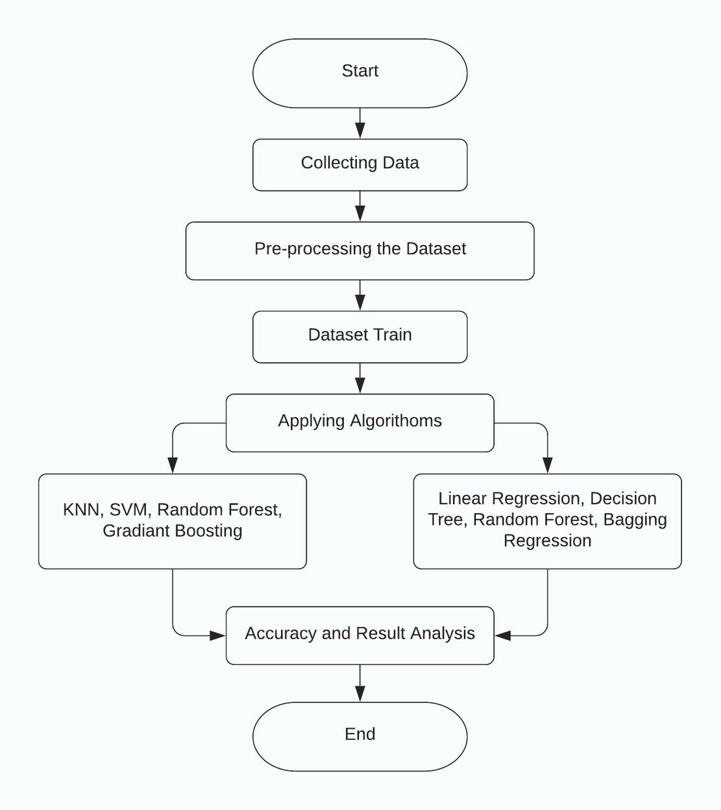
METHODOLOGY
Methodology is the study of ideas, procedures, and principles related to a certain topic or issue. To establish a new field of study, a wide variety of research papers are required. Each study recommends a different career path, but In the end, it is a collection of recommendations for future scientific analysis in a certain area.
WORKFLOW DIAGRAM
7

Slide 8


Support Vector Machine (SVM)
K-Nearest Neighbor (KNN)
Random Forest
Linear Regression
Bagging Regression
PREDICTION ALGORITHM / CLASSIFIER ALGORITHM
Movie Recommendation
8

Slide 9

Our
DATASET
We have used Movielens datasets -
-We have worked with 9000 movies datasets and among them, 3600 data are tested.
For Movielens -
-movies data
-users' data
-ratings data
9

Slide 10


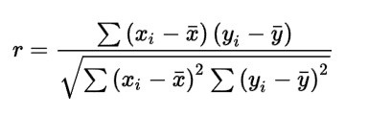
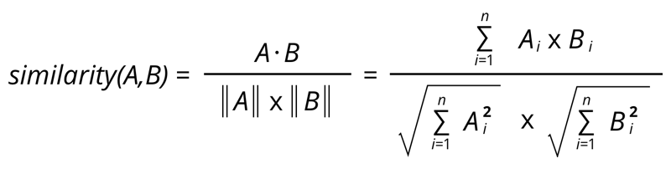
Our Used
METHODS
PEARSON CORRELATION
COSINE SIMILARITY
10

Slide 11







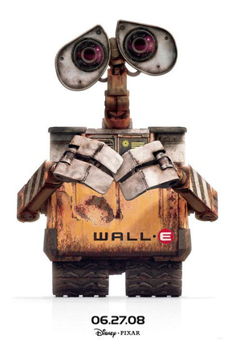



Similar Movies

Slide 12
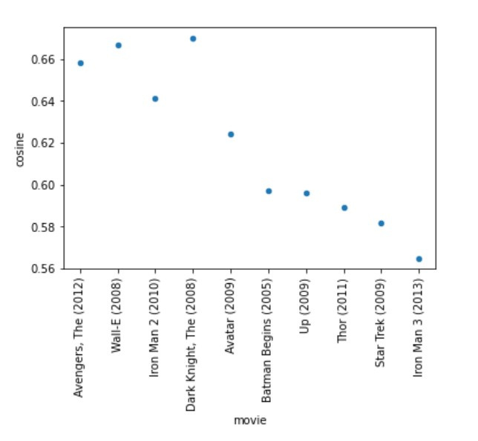
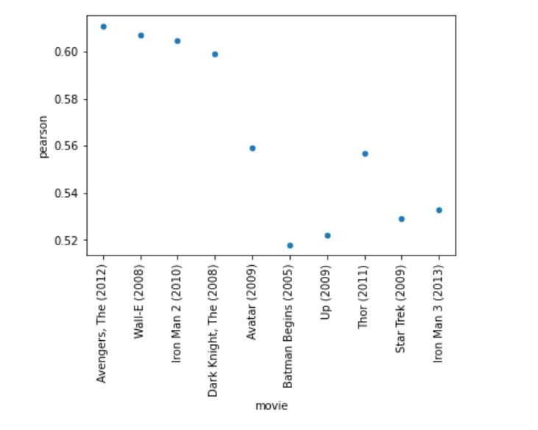

PEARSON RESULTS
10 most highly suggested films for fans of “Iron Man (2008)” based on pearson correlation
COSINE RESULTS
10 most highly suggested films for fans of “Iron Man (2008)” based on cosine similarity
Movie Recommendation
12

Slide 13


MODEL IMPLEMENTATION
ML models are trained on the training set of 70% data to learn and then evaluated with the assistance of 30% data is been tested.

Slide 14
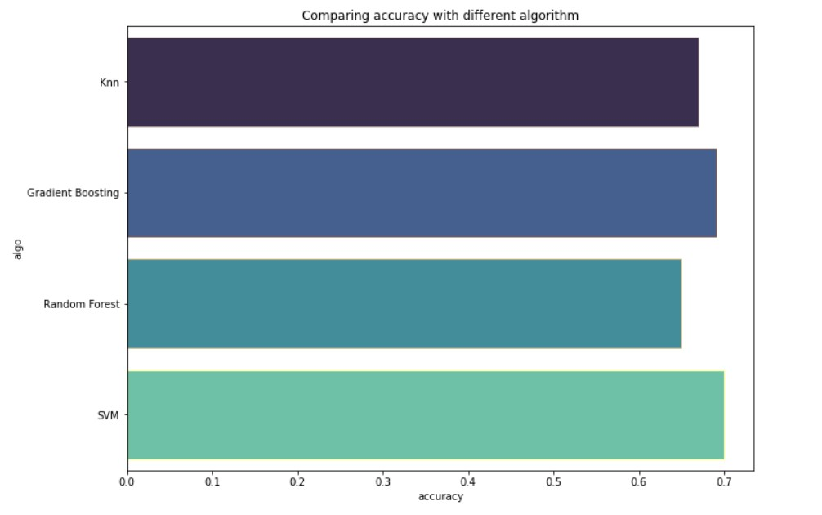

Our
MEAN
ACCURACY
Movie Recommandation
14

Slide 15
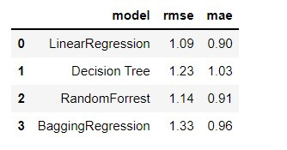
THE RESULT ANALYSIS
The Baseline Rmse is 1.12
The Baseline Mae is 1.02
15

Slide 16

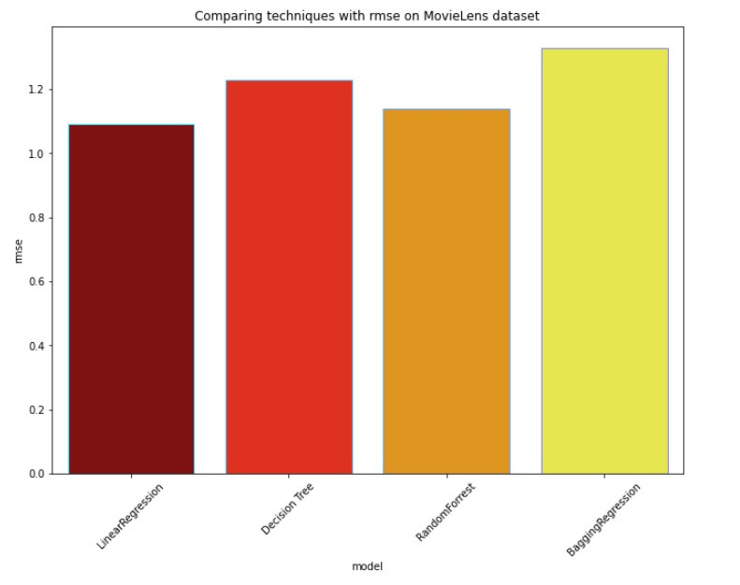
COMPARING MODEL
Movie Recommentaion
16

Slide 17
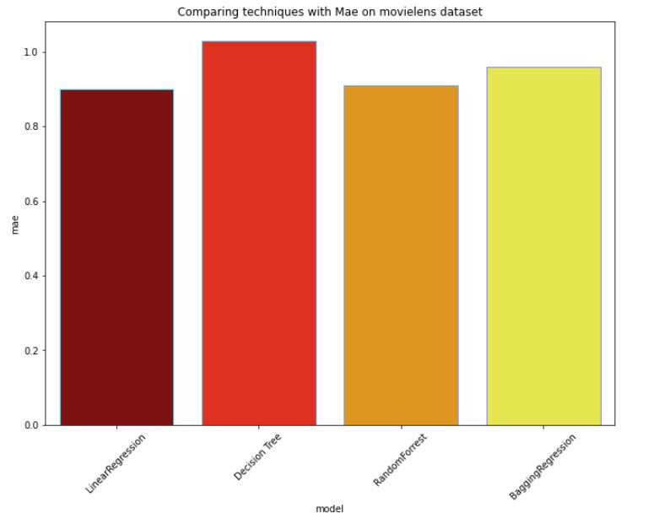
COMPARING MODEL
Movie Recommentaion
17

Slide 18
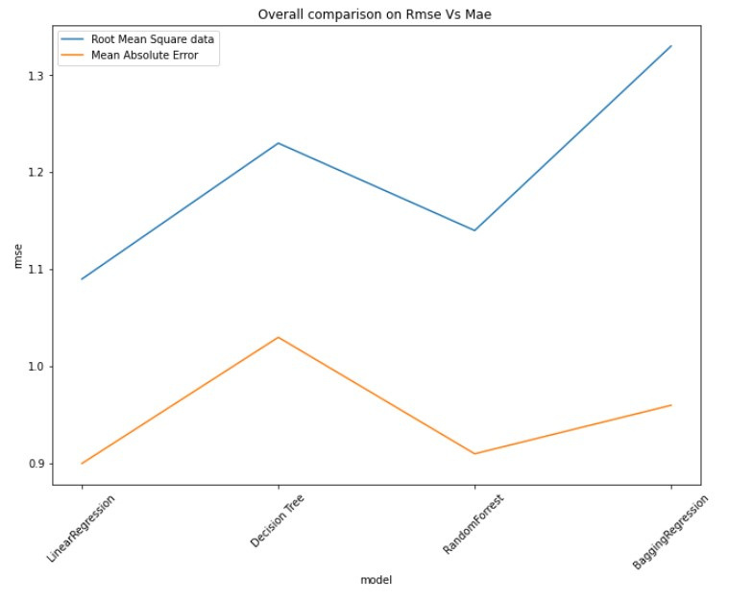

RMSE
VS
MAE

Slide 19
Determine which aspects of performance deserve attention so that corrective measures can be taken.
For finding the accuracy and error.
If we can find those we can resolve the
existant challanges.
Provide suggestions on how to improve the quality of future work and strategies to do so.
Get a clearer understanding on how things actually happen
Why our analysis is
Important for the
implementation
Movie Recommendation
19

Slide 20





OUR PROGRESS
Using huge data
Good Result with Dataset
Compare Result with others
Comparative accuracy

Slide 21



Our
LIMITATIONS
LACK OF RESOURCES
COMPUTATION POWER
Movie Recommandation
21

Slide 22
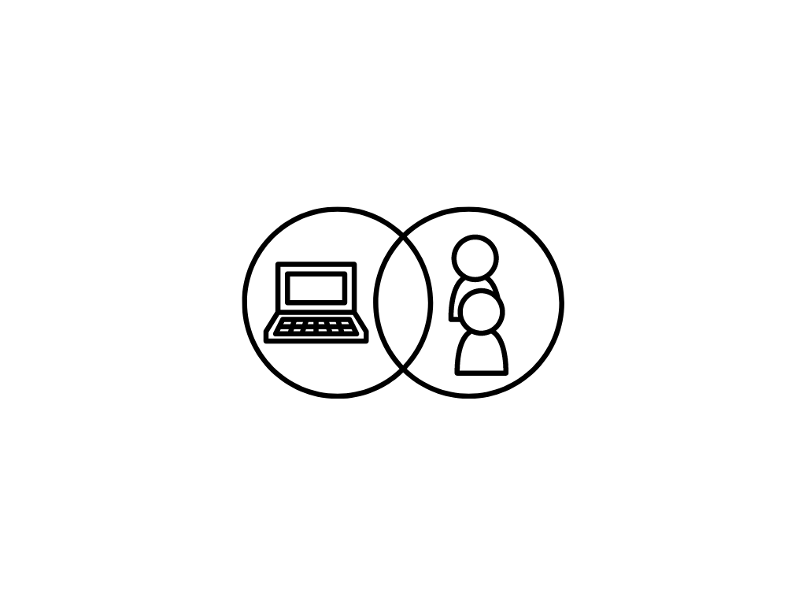





Our
FUTURE WORK & SCOPE
HYBRID RECOMMENDER FOR BETTER OUTPUT
INCREASE Our KNOWLEDGE of CF APPROACHES AND SCALING.
USING DEEP MACHINE LEARNING
Decrease The
RMSE and
MAE.
SOLVING COLD START ISSUE
(MATRIX FACTOR ALGO)
RUN
LARGER
DATASET
Movie Recommendation
22

Slide 23

CONCLUSION
•There has been a lot of work done in the field of recommending products such as movies so far.
•However, because the movie recommendation process is not a static issue, the efficiency and accuracy can be improved over time with more and more research.
•In this paper, we looked at various approaches to making movie recommendations as accurate as possible.
23

Slide 24

THANK YOU

